Slide 1
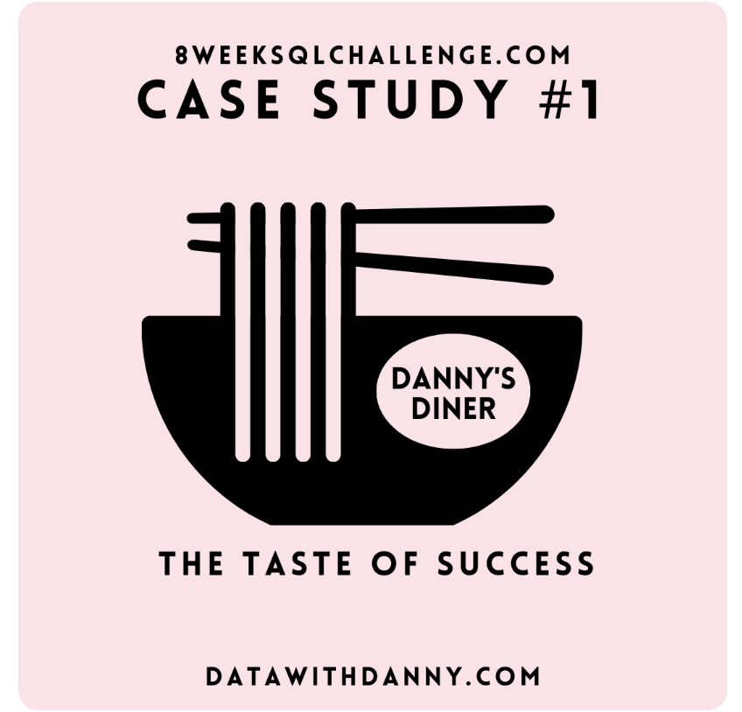
Danny's Diner SQL Case Study:
An Analysis Using PostgreSQL
BY
NAVEED ALI

Slide 2
Introduction
Danny seriously loves Japanese food so in the beginning of 2021, he decides to embark upon a risky venture and opens up a cute little restaurant that sells his 3 favorite foods: sushi, curry and ramen.
Danny’s Diner is in need of your assistance to help the restaurant stay afloat - the restaurant has captured some very basic data from their few months of operation but have no idea how to use their data to help them run the business.
Problem Statement
Danny wants to use the data to answer a few simple questions about his customers, especially about their visiting patterns, how much money they’ve spent and also which menu items are their favorite. Having this deeper connection with his customers will help him deliver a better and more personalized experience for his loyal customers.
He plans on using these insights to help him decide whether he should expand the existing customer loyalty program - additionally he needs help to generate some basic datasets so his team can easily inspect the data without needing to use SQL.
Danny has provided you with a sample of his overall customer data due to privacy issues - but he hopes that these examples are enough for you to write fully functioning SQL queries to help him answer his questions!

Slide 3
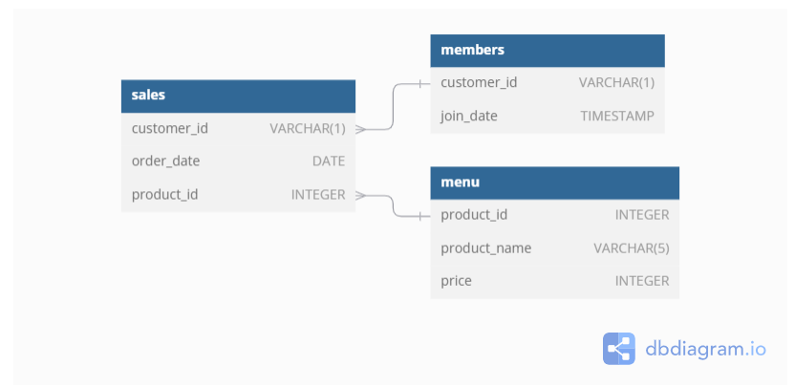
Danny has shared with you 3 key datasets for this case study:
Sales
Menu
Members You can inspect the entity relationship diagram and example data below.

Slide 4
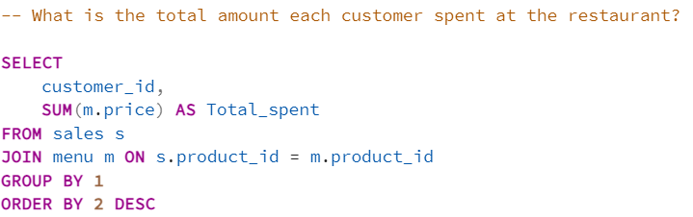
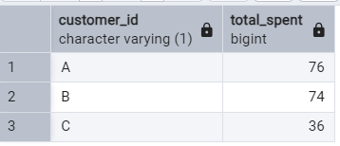
Result

Slide 5
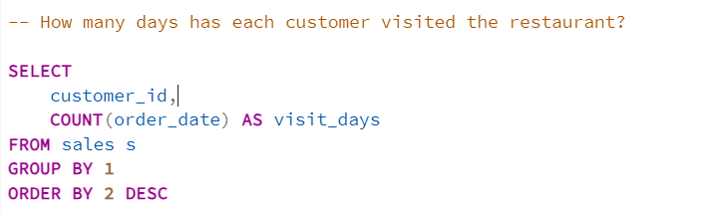
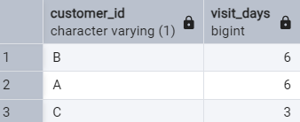
Result

Slide 6
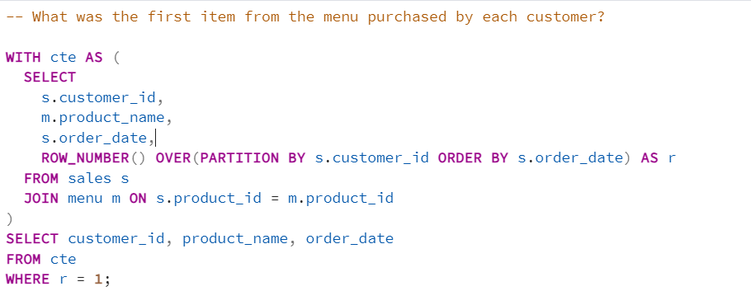
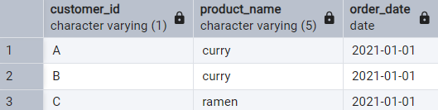
Result

Slide 7
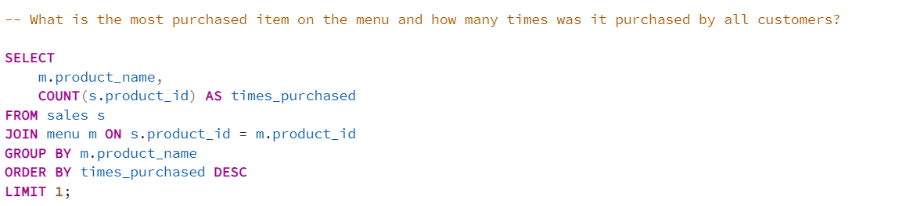

Result

Slide 8
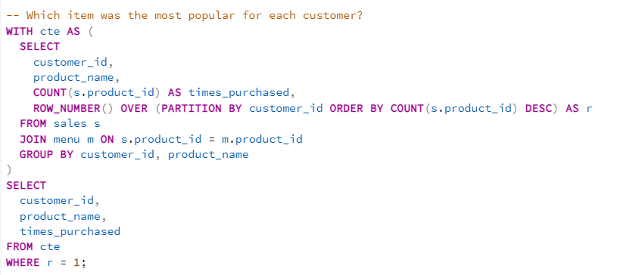
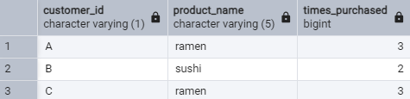
Result

Slide 9
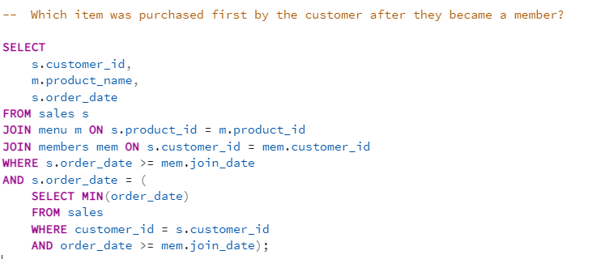

Result

Slide 10
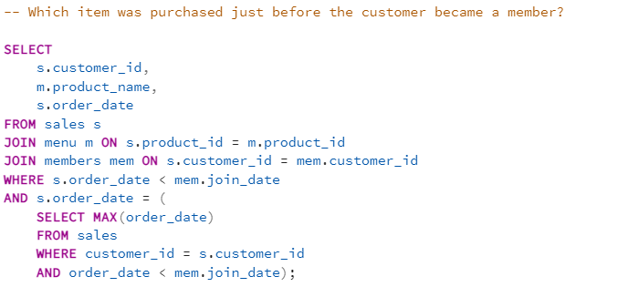
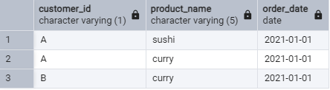
Result

Slide 11
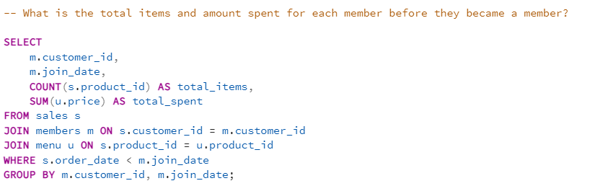

Result

Slide 12
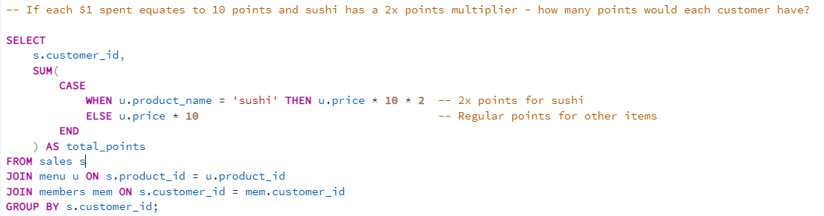
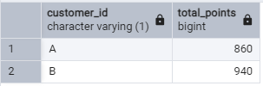
Result

Slide 13
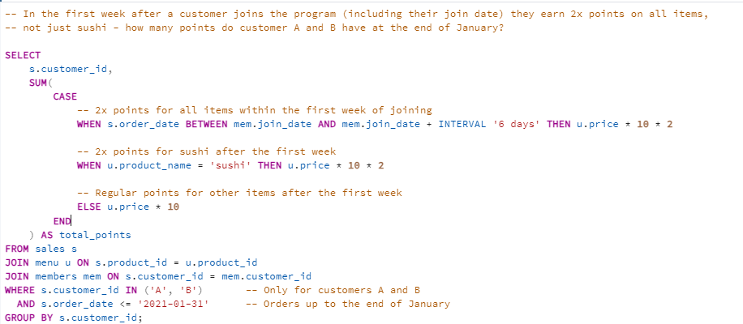

Result

Slide 14
THANKS
For the database schema, please visit my GitHub or portfolio to access the detailed schema and related resources. The links are available in the post description.

